Slide 1
MEDITRACK
Team Details:
Harshita : 2310990601
Moorvi Garg : 2310990659
Jashan Yadav : 2310992105
Aditi Batra : 2310992582
Faculty Co-Ordinator : Mr. Adil Khan
:
Chitkara University Institute of Engineering and Technology,
Chitkara University, Punjab

Slide 2
Table of Contents
Introduction
Problem Statement
Technical Details
Backend
Project Flow
Key Features
Project Highlights
Conclusion

Slide 3
Introduction
Project Overview:
This project is a medicine management and booking platform that facilitates the seamless interaction between users and shopkeepers to manage and purchase medicines. The objective is to simplify the process of finding, booking, and managing medicines with an easy-to-use web application interface.
Key Points
This project uses Java, Spring Boot, HTML, CSS, JavaScript, and MySQL for backend, frontend, and database implementation

Slide 4
Problem Statement
Manual medicine management in traditional retail settings is time-consuming and prone to errors, which often results in issues such as stockouts, outdated inventory data, and inefficient communication between sellers and buyers. Customers may face significant inconveniences: inability to find required medicines on time, incorrect or insufficient stock details, and delays due to clunky offline processes. Shopkeepers, on the other hand, struggle to monitor stocks, manage expiries, and handle bookings swiftly, all risking business and customer trust.

Slide 5
Technical Details
Frontend: HTML, CSS, JavaScript
Backend: Java with Spring Boot framework
Database: MySQL
APIs: RESTful services for CRUD operations
Build Tool: Maven (using dependencies such as spring-boot-starter-web, spring-boot-starter-data-jpa, spring-boot-starter-security, and MySQL connector).

Slide 6
Backend
The backend is powered by Spring Boot and exposes REST APIs for user management, inventory, and bookings. It utilizes JPA for database access and Spring Security for basic authentication and input validation. Relevant configuration and dependencies are specified in the Maven pom.xml, allowing for scalable and modular development

Slide 7
Project Flow:
Users can browse medicines, search and sort them, and add their details locally.
Shopkeepers manage inventory, update stock and expiry information, and handle bookings.
Booking triggers a creation of user profiles if not present, then reserves the requested quantity and reduces the stock in the database.
All events are reflected through dynamic, responsive interfaces for both users and shopkeepers

Slide 8
Key Features
Real-time medicine inventory management
Stock and expiry validation with alert messages
User and shopkeeper specific interfaces
Robust search, sort, and filter capabilities
Secure, API-driven booking system
Error handling and validation of user inputs

Slide 9
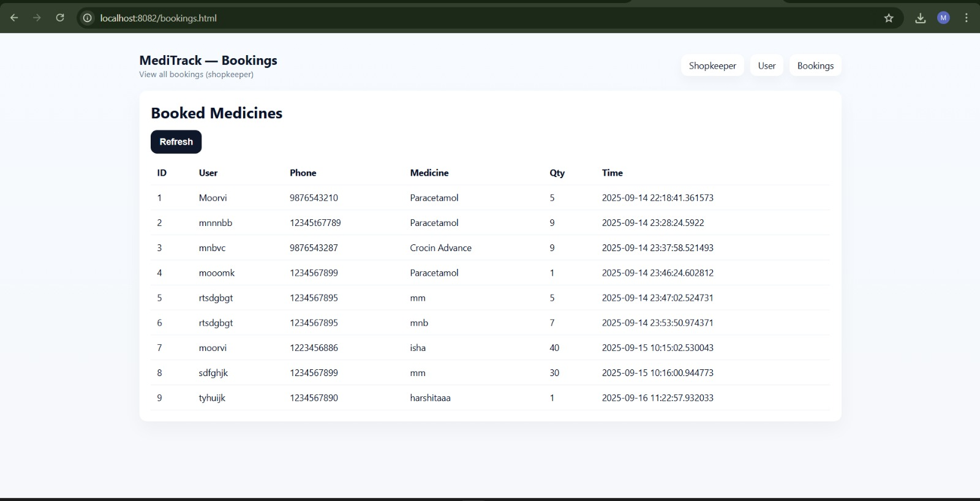
Project Highlights

Slide 10
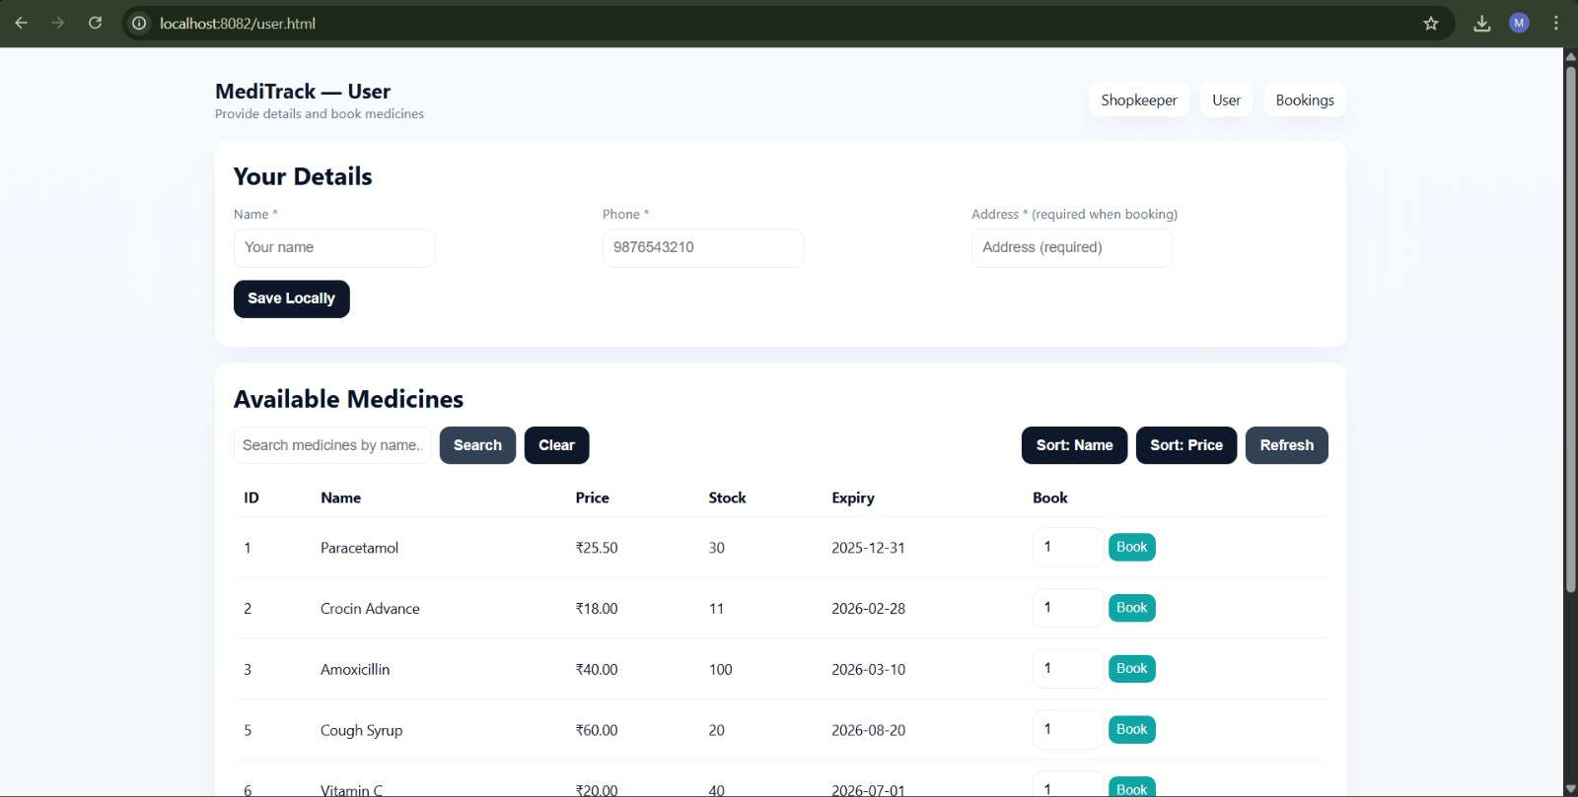

Slide 11
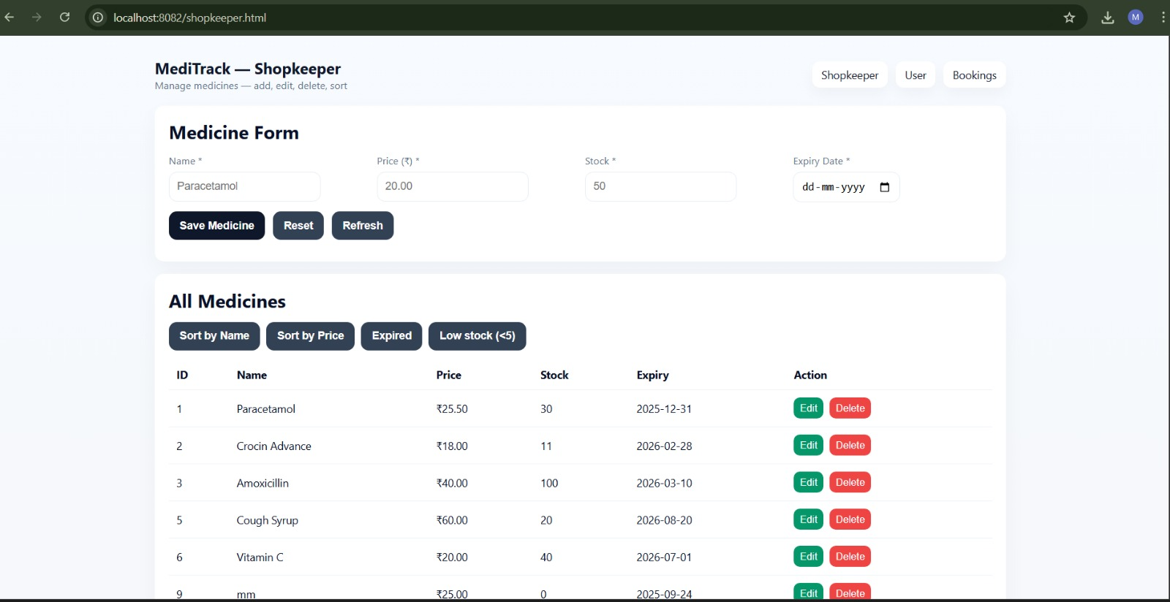

Slide 12
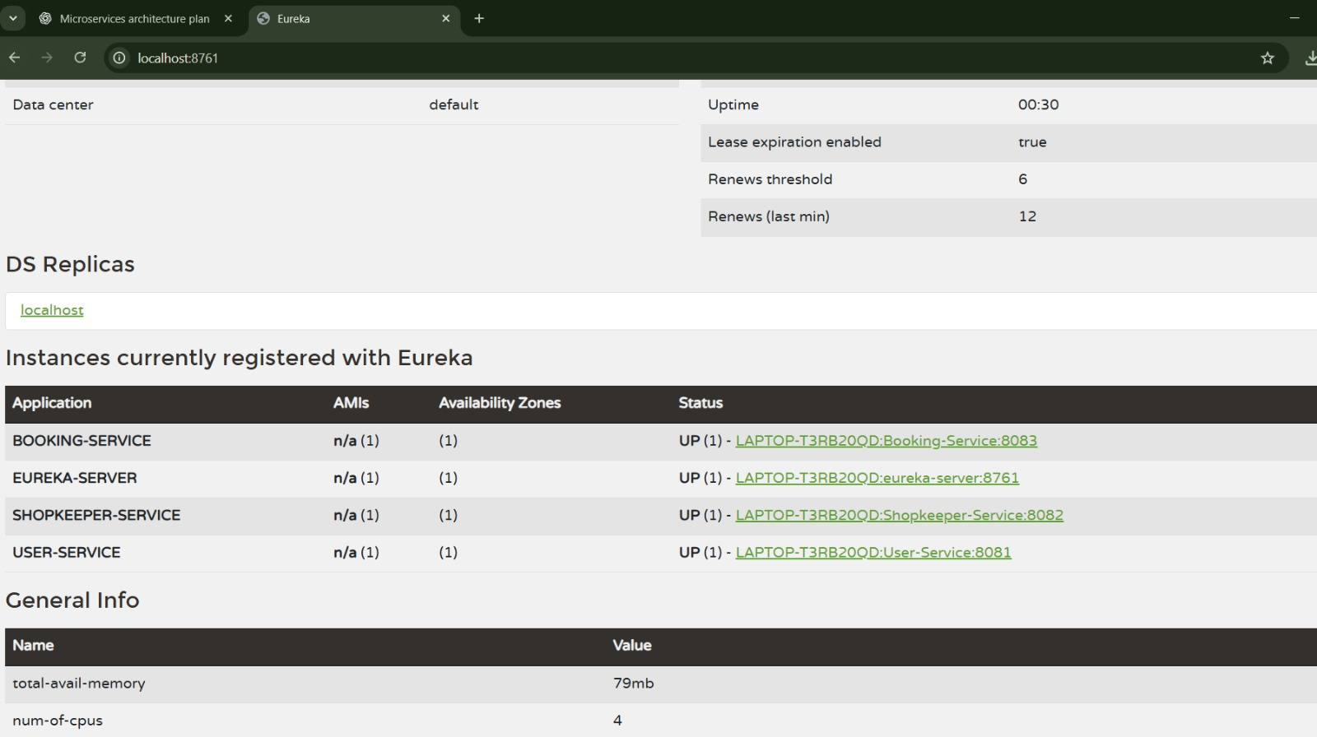

Slide 13
Conclusion
The project delivers a technology-driven solution for streamlining medicine management and booking, leading to improved efficiency, reliability, and user satisfaction. With its scalable architecture, the platform can be further expanded to support more features and handle larger user bases in real-world deployments.

Slide 14


